Slide 1
Heuristic Method Backtracking and
Predictive Analysis using Random Forests Classifier
By
Yash Parikh
Aakash Rana
Abishek A

Slide 2
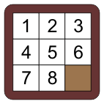
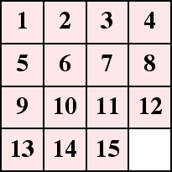
15-Puzzle Problem
8-Puzzle Problem n-Puzzle Problem

Slide 3
Different Heuristics to achieve the Goal-state
Number of tiles out of position
Manhattan Distance
Tiles out of row and tiles out of column
Pattern Database
Heuristic we used:
Number of tiles out of position

Slide 4
Coding Conventions
Class of dmin which calculates the heuristics and checks if the goal state is reached
Takes input as the present state of matrix and the target matrix
Sets a maximum heuristic of 1000 and calculates heuristic for the current configuration and performs the necessary moves
0 is used for the space

Slide 5
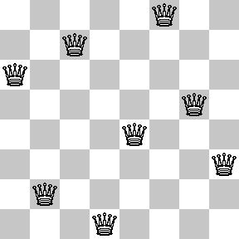
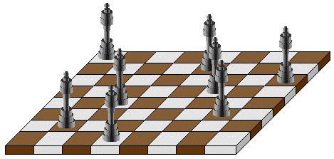
n-Queens Problem
To place n queens in nXn chess-board such that no two queens attack each other

Slide 6
n-Queens Problem
Ways to solve n-queen problem
- Backtracking
- Heuristic(elimination number)
- Simulated Annealing
For 8-queen, we have 92 solutions.
If we exclude symmetry, there are 12 solutions.

Slide 7
Coding Conventions
A public class of queen with a constructor to define the number of queen-problem to be solved.
An array x which keeps track of the positions of all the queens according to the index.
canPlaceQueen(int r,int c) method with two parameters which returns TRUE if a queen can be placed in row r and column c.
placeNqueens(int r,int n) method with two parameters prints all possible placements of n queens on an n x n chessboard so that they are non-attacking.
canplaceNqueens() which returns the number of permutations possible.
printQueens(int[] x) which prints the status of chessboard in the goal state according to positions described by the array x.

Slide 8
Titanic: Machine Learning From Disaster
Predictive Analysis using Random Forests Classifier

Slide 9
The Problem Statement
On April 15, 1912, during her maiden voyage, the Titanic sank after colliding with an iceberg, killing 1502 out of 2224 passengers and crew.
One reason was less number of lifeboats.
Some groups of people were more likely to survive than others, such as women, children, and the upper-class.
We complete the analysis of what sorts of people were likely to survive.

Slide 10
The Dataset
Survival (0 = No; 1 = Yes)
Pclass: Passenger Class (1 = 1st; 2 = 2nd; 3 = 3rd)
Name
Sex
Age
Sibsp: Number of Siblings/Spouses Aboard
Parch: Number of Parents/Children Aboard
Ticket: Number of ticket
Fare: Passenger Fare
Cabin
Embarked: Port of Embarkation (Discrete)

Slide 11
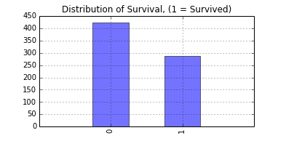
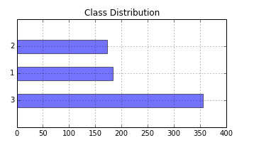
Understanding the Dataset

Slide 12
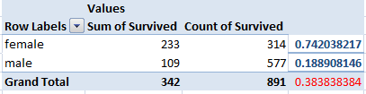
Preliminary analysis
If we predict survival just on the basis of Sex only, we get 76.55% accuracy on the test data on Kaggle.
Hence, Sex is the most important attribute of our training data

Slide 13
Data Munging
The first step is to convert our data into a format which the classifier can work on.
E.g. float, int
We mapped Sex{Female, Male} to {0, 1}
Also, we mapped Embarked{S, C, Q} to {0,1,2}

Slide 14
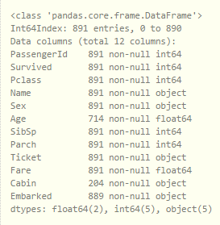
Analyzing Missing Values

Slide 15
Data Cleaning: Missing Values
The second step is to fill the missing data with appropriate values. Python package pandas can be used to observe the count of missing values.
Age has 177 missing values while Cabin has 687 missing values.
Since, cabin was only given to first class people, it doesn’t tell us much about the data.

Slide 16
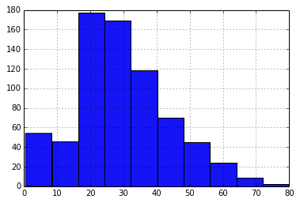
Data Cleaning: Age
Age distribution

Slide 17
Data Cleaning: Age
Mean of Age column is 29.69 years. The Age histogram did seem skewed.
To reduce the influence of a few rare 70-80 year olds, using median for filling missing values would be a better choice to reduce the overall noise.

Slide 18
Feature Engineering
Couple of other features were created which tells us more about the data.
Family Size = No of siblings/spouses + No of parents/children
Age * Class: More the magnitude of this feature, lesser the chances of survival

Slide 19
Further Possible Features
Title: Captains and Reverends and Doctors have better chances of survival.
title_list=['Mrs', 'Mr', 'Master', 'Miss', 'Major', 'Rev‘, 'Dr', 'Ms', 'Mlle','Col', 'Capt', 'Mme', 'Countess', 'Don', 'Jonkheer']
Deck: Cabin number is like ‘C123’ where C is for the deck. This is how cabin column could be made useful.

Slide 20
Further Cleaning of Data
After mapping textual data to float, we should drop those columns.
Also, columns such as ‘Name’, ‘Ticket’ and ‘Cabin’ does not influence the data set and survival prediction much.
Hence, we drop those columns.
Now we have our data in the format that can be fed to our classifier.

Slide 21
Training our Data: Random Forests
Normal decision trees may overfit the data because they have low bias, but very high variance.
Random forests are a way of averaging multiple deep decision trees, trained on different parts of the same training set, with the goal of reducing the variance.

Slide 22
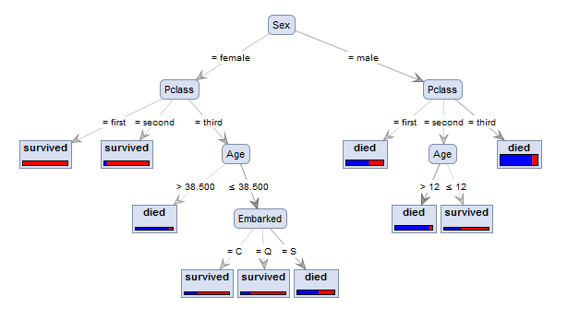
Sample tree using ID3

Slide 23
Decision Tree Formation
The decision tree is built on the basis of priority of the following attributes.
Sex -> Class -> Age -> Embarkment
The more the priority of an attribute, the more it is towards the root in the decision tree.
Leaf nodes are assigned boolean values on the basis of the chances of survival.

Slide 24
Conclusion
The Random Forests model gave 82.12% accuracy on the Kaggle test data set which is an improvement over the preliminary analysis where we didn’t use machine learning.
Simple model is not always a bad model. Sometimes, concise, simple views of data reveal their true patterns and nature.

